Slide 1
Data Science Club - Week 6
Logistic Regression + Confusion Matrix
By Kevin and Vincent

Slide 2
01
Logistic Regression

Slide 3
Logistic Regression
Logistic Regression is a classification algorithm used to predict a variable based on previously presented data
Used to classify things such as fraudulent or spam
Examples:
Fraud Detection - amount, location, and transaction date
Spam Detection - sender, word usage, typos
Website Visitor Behavior - time spent, number of items

Slide 4
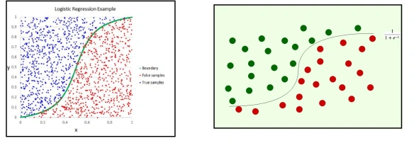
Example of a Logistic Regression model
Fitting to a sigmoid function curve,

Slide 5
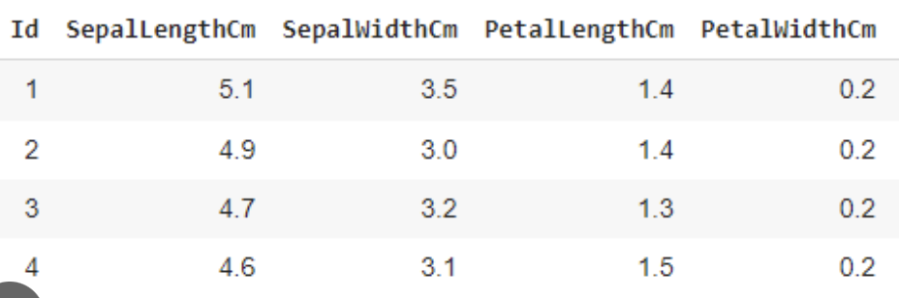
Example: Iris Dataset
Dataset: Iris flower features (e.g., sepal length, petal width) and their species.
Goal: Predict whether a flower is Iris-setosa (0) or Iris-versicolor (1).
Features: Sepal length, petal length, etc.
Code for Logistic Regression from sklearn.linear_model import LogisticRegression
model = LogisticRegression()
model.fit(X_train, y_train)

Slide 6
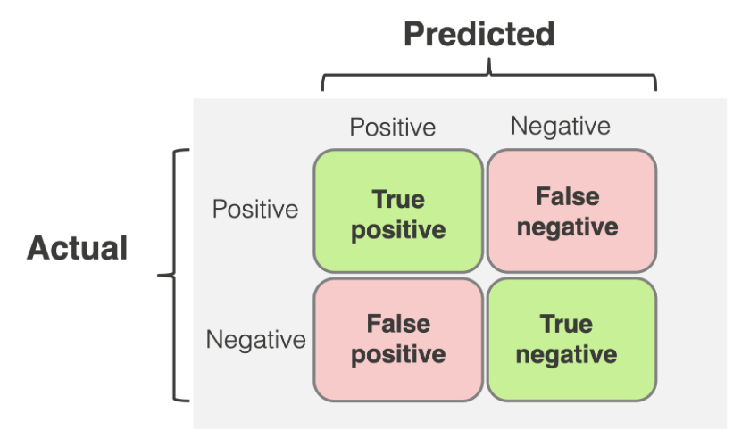
Confusion Matrix
Tests the accuracy and precision of the model by using a confusion matrix to find out if the model classified data correctly
[15 1]
[2 12​]

Slide 7
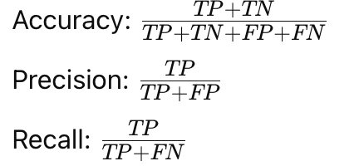
Metrics for Confusion matrix
TP = True Positive
TN = True negative
FP = False positives
FN = False negatives

